Slide 1
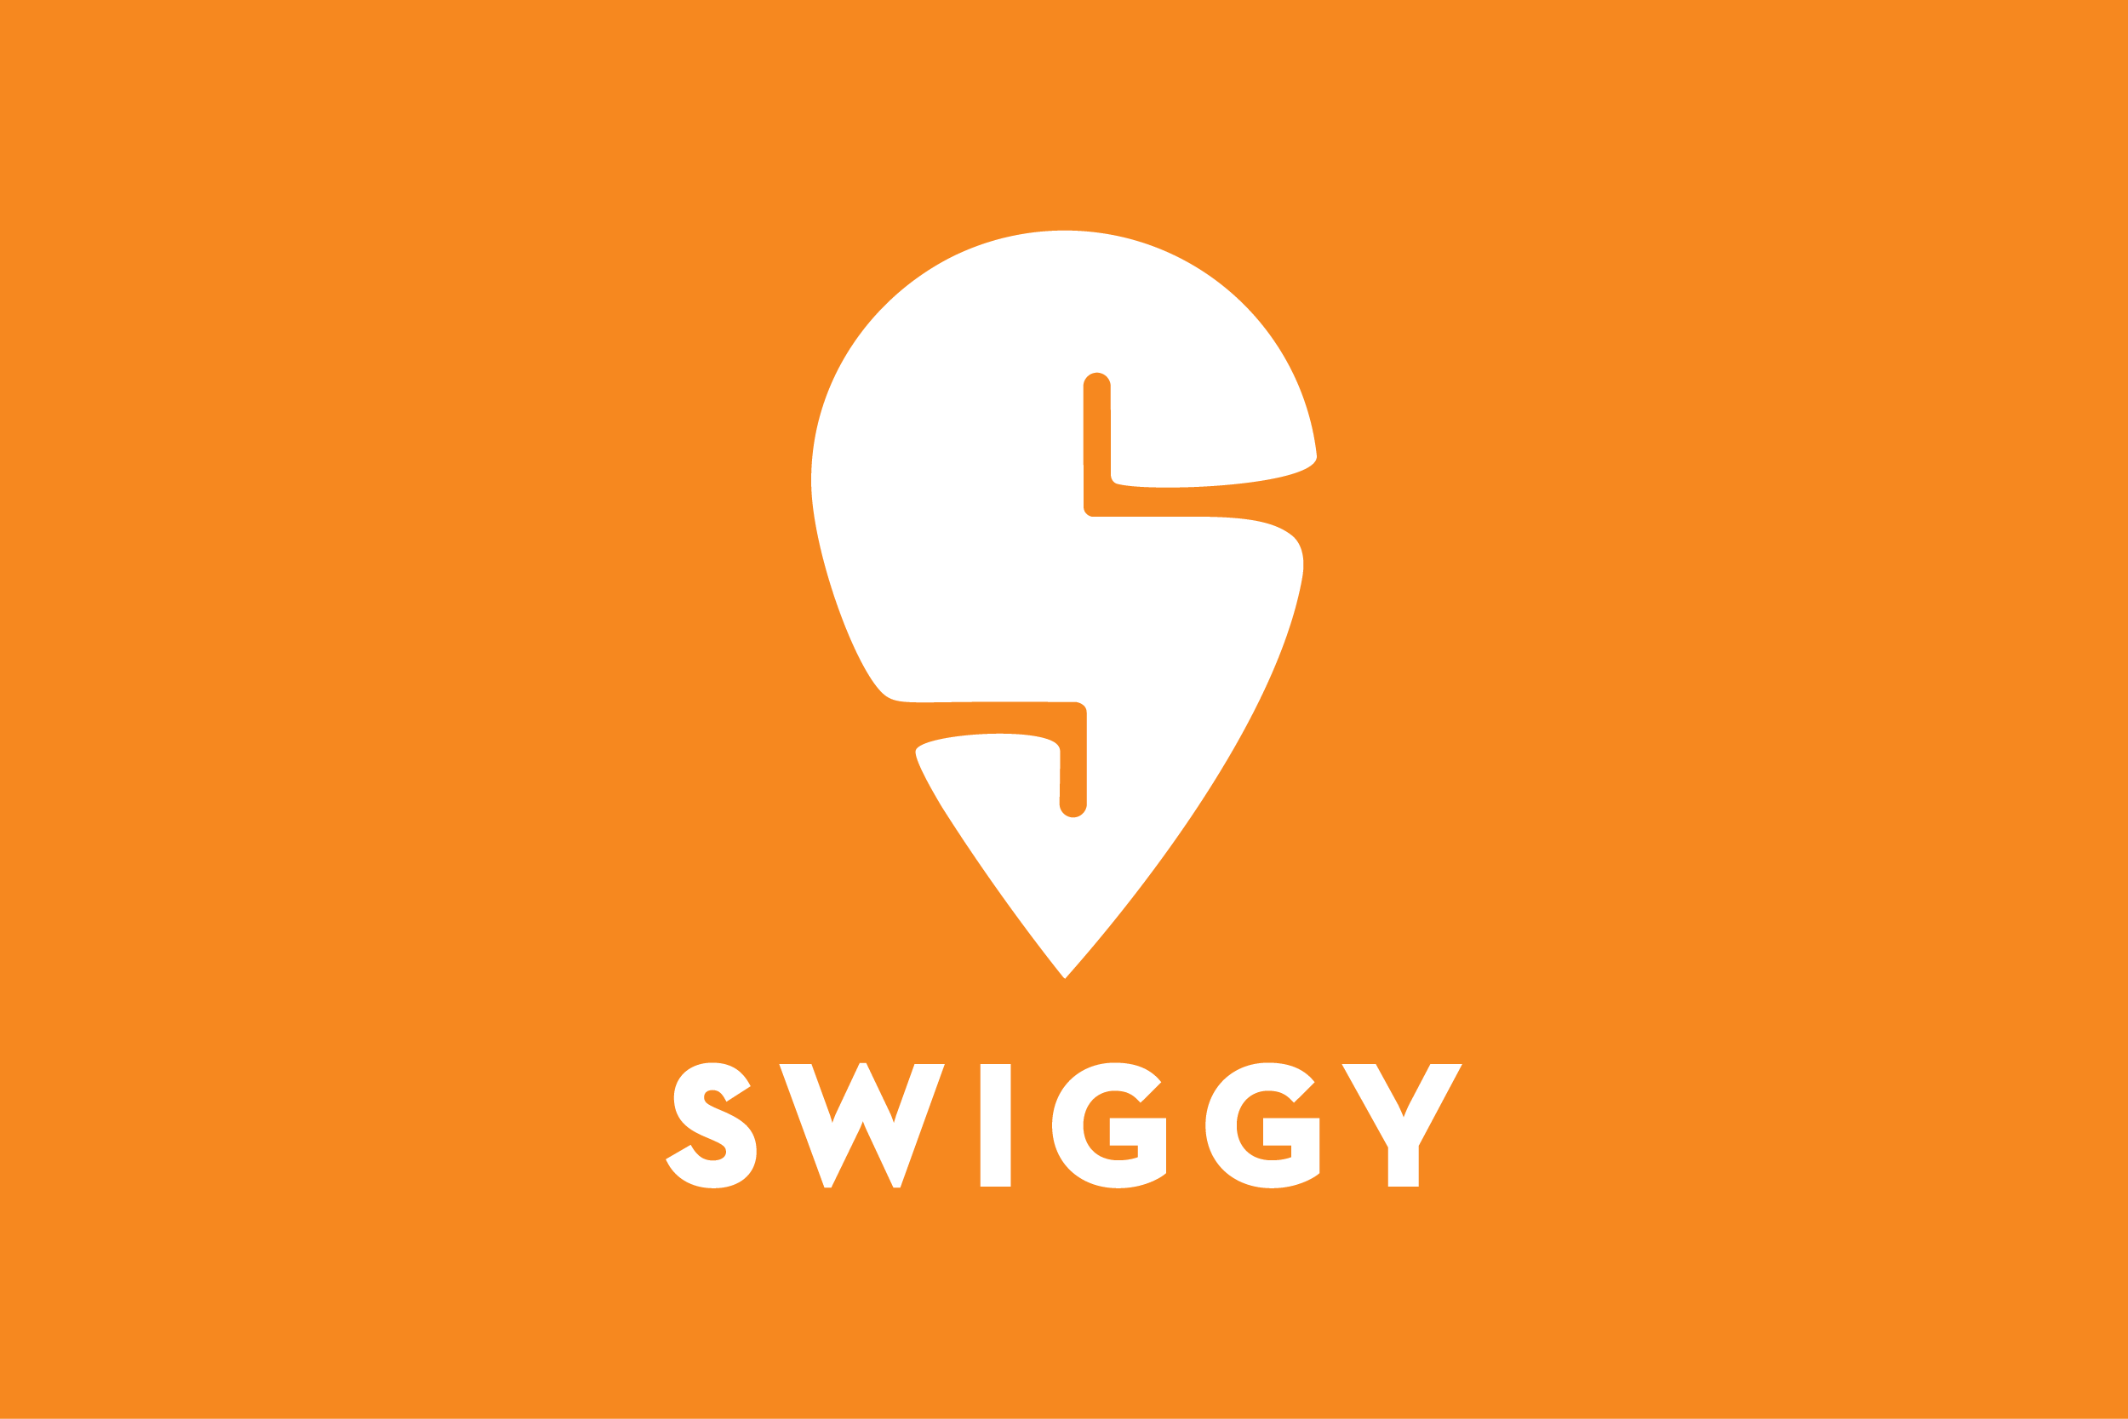
Restaurant Recommendation model Devendra Padasala Ashish Kumar Rahul Bisht Anish Shaw

Slide 2
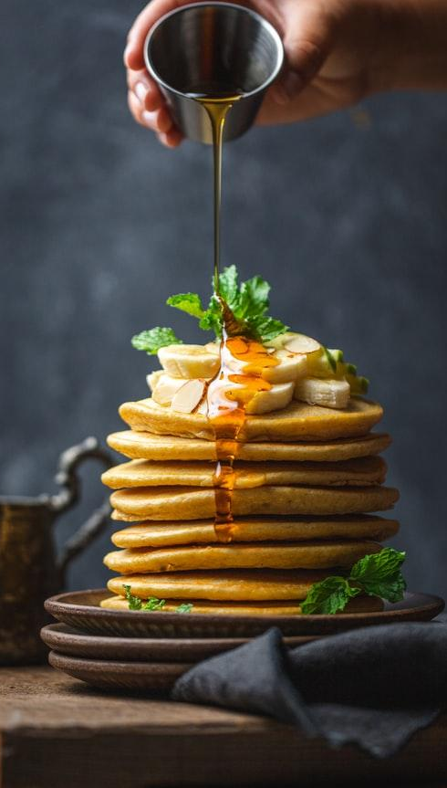
Introduction
Problem Statement:
Build a recommendation model for someone who wants to open a restaurant in Bangalore.
Solution:
Scraped restaurant data for Bangalore from the Swiggy website.
Leveraged a machine learning model to develop recommendations.
Developed a web-based application that provides personalized suggestions based on user inputs.

Slide 3




Tools used for Analysis
Web Scrapping
Deployed the Python library Beautiful Soup to scrape restaurant data from Swiggy
Data Cleaning
Utilized Pandas and Excel to clean the dataset by removing null and redundant columns
Employed a combination of machine learning algorithms as collaborative filtering, content based filtering and matrix factorization.
Model Building
Utilized the Flask library to deploy our machine learning model.
Deployment of Model

Slide 4
Data preprocessing
Deployed the Python library Beautiful Soup to scrape restaurant data from Swiggy. First we extracted the data from swiggy webpage for different restaurant name, cuisines, star_rating then for a particular restaurant we extracted data of different dishes, categories ,number of the ratings.
From the extracted data we created two tables and merged them by using panda.
Pandas was utilized to replace null values with the mean and mode, as well as to clean noise and removing the outliers from the data.
.

Slide 5
Model Building
We have used machine learning algorithms such as collaborative filtering, content-based filtering, and matrix factorization.
Collaborative filtering :- Collaborative filtering predicts a user's preference by analyzing similar users' interactions with items. It can identify popular restaurants and cuisines and suggest new restaurants based on the user's preferred cuisine.
content-based filtering :- Content-based filtering uses item attributes to make recommendations. It predicts user preference based on restaurant attributes like cuisine, location, and price. It can suggest the best location based on a user's preferred cuisine and price
Matrix-Factorization :- Matrix factorization is a machine learning technique that decomposes a large data matrix into smaller matrices for easier analysis.
.

Slide 6
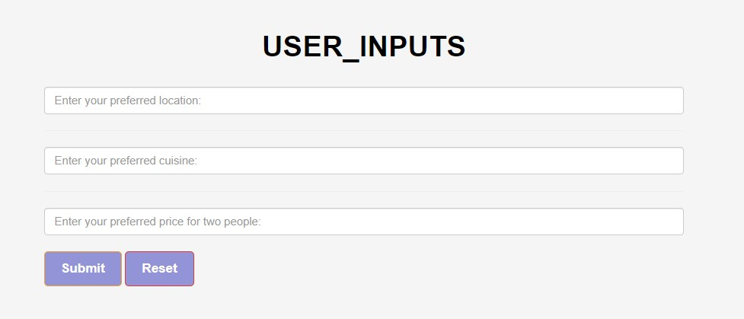
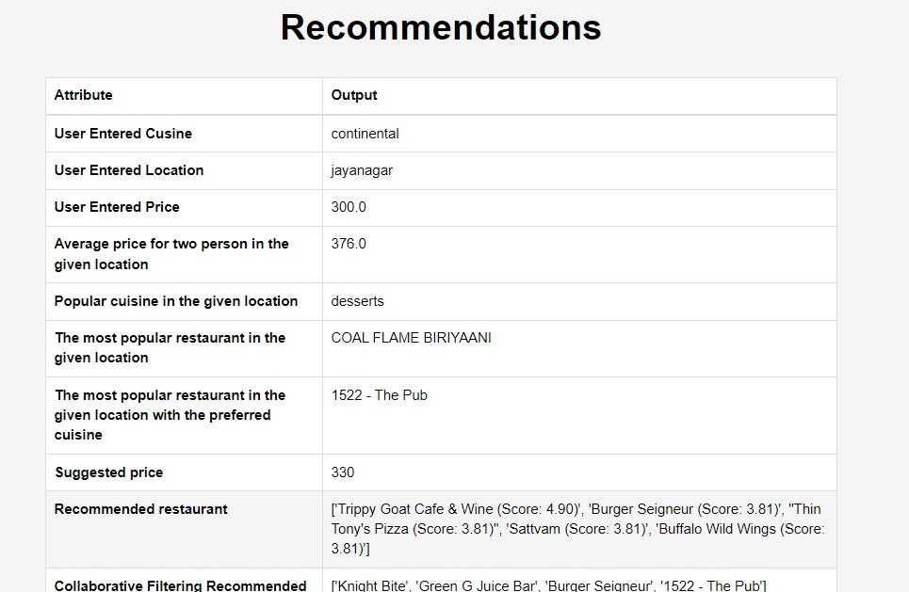
Deployment
Flask environment :- Created the flask environment in Pycharm and there are some flask application structure given below .
Flask routes are used to display the page of the hotel recommendation and other relevant pages like home page.
User_input and recommendation page are shown aside .
.

Slide 7
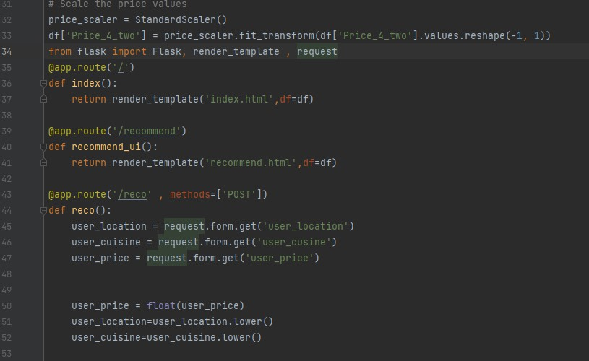
Flask Application structure
.

Slide 8
Key Findings
The top five locations in Bangalore with high ratings of 4.5 and above are Ashok Nagar, Indiranagar, Jayanagar, Koramangala, and Vasanth Nagar.
Furthermore, the number of restaurants in these locations is also high.
.

Slide 9
Key Findings
In Bangalore, the most popular cuisines that are sold are Beverages, Chinese, Desserts, and North Indian.
These are the costly dishes in Bangalore:-
Al Zara Spl Mix Mand,
Butter Naan Combo,
Chicken Ghee Roast,
Mutton Biryani + 4 Pcs Kebab
Mutton Biryani + Cool Drink[r]+2piece Chicken Kabab
Veg Chilli Garlic Rice + Paneer In Hot Garlic Sauce
.

